Slide 1
Midbrain and Diencephalon
NSC 4130 LAB 8

Slide 2
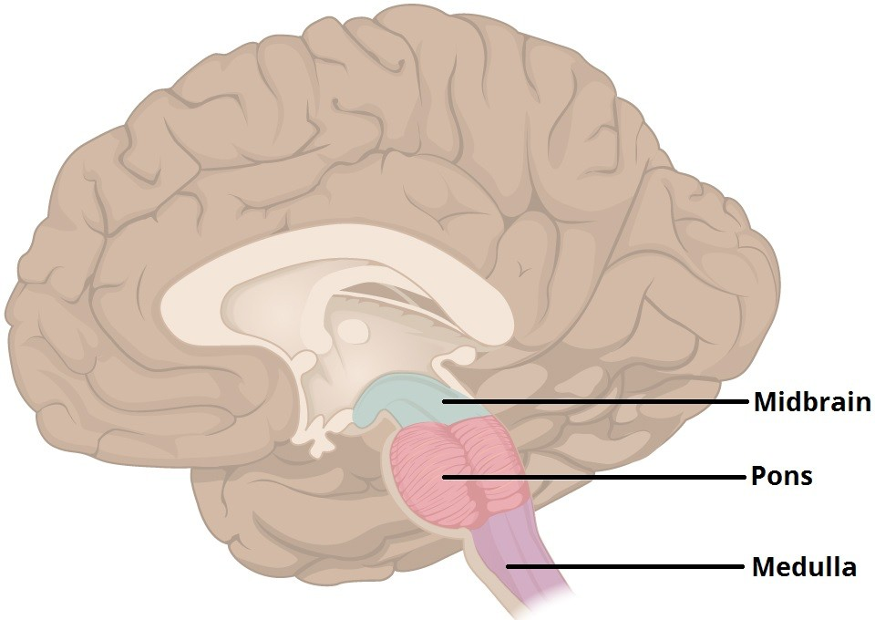

Slide 3
Midbrain Functions
Also known as the Mesencephalon
Associated senses:
  Vision
  Hearing
Associated autonomic functions
  Motor control
  Sleep/wake
  Arousal (alertness)
  Temperature regulation

Slide 4
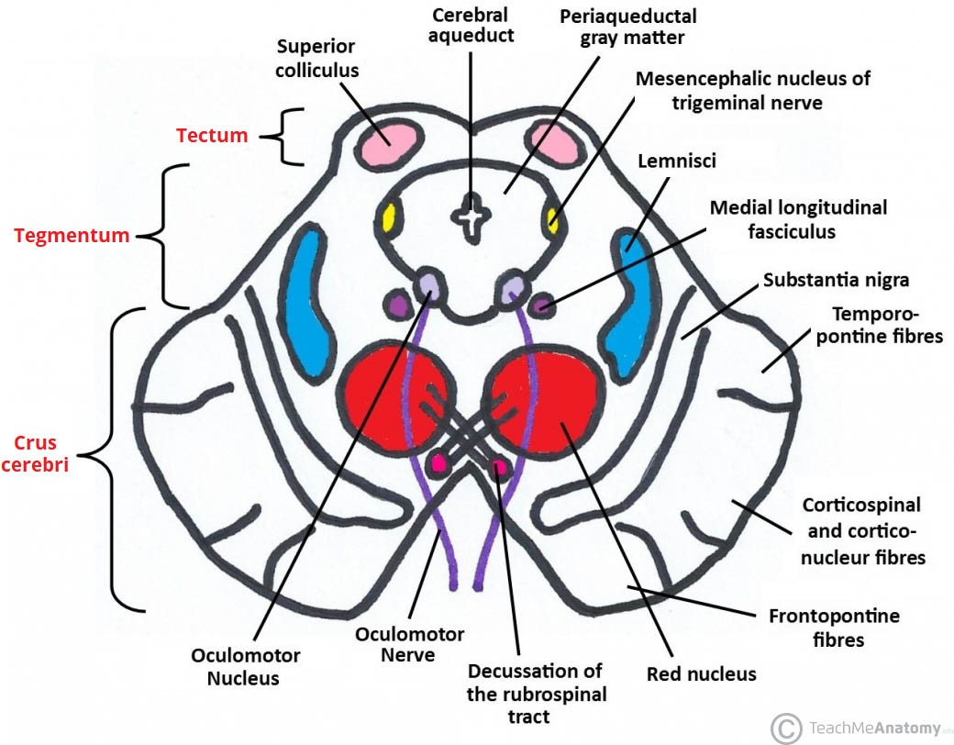
Rostral Midbrain

Slide 5
Midbrain Structures
Tectum
  Dorsal side of the midbrain
  Reflex actions in connection with visual or auditory stimuli.
  The reticulospinal tract- exerts some control over alertness and takes input from the tectum.
  The superior colliculi – process visual information, aid the decussation of optic nerve fibers, and is involved in saccadic eye movements.
  The inferior colliculi- process certain auditory information.

Slide 6
Tegmentum Structures
Red Nuclei
  Gait
Medial Lemniscus
  Somatosensation from the skin and joints
Reticular Formation
  Production of serotonin
  Arousal
  Consciousness
  Motor coordination
  Exhalation

Slide 7
Midbrain Structures
Cerebral Aqueduct
  Connects 3rd and 4th ventricles
    Responsible for continuing the circulation of cerebrospinal fluid
    The smallest ventricle in the ventricular system
    Located between the tectum and tegmentum and is surrounded by the periaqueductal grey, which has a role in analgesia, bonding, etc.
  2 major ocular nerve tracts, run directly adjacent

Slide 8
Midbrain Structures
Crus Cerebri (Basis Pedunculi)
  Contains the corticobulbar and corticospinal tracts
  Other tracts connecting the cortex to the pons
  Substantia nigra – the only part of basal ganglia system outside of the forebrain
    Pars compacta and pars reticulata
    Motor planning, learning, addiction, and other functions.
    High production of melanin, dopamine, and noradrenaline.

Slide 9
Diencephalon Structures
Thalamus
  Sub-structures include subthalamus and epithalamus
  Serves as a relay center for sensory and motor impulses between the spinal cord, medulla, and cerebrum.
  Recognizes sensory impulses of heat, cold, pain, pressure, vision, taste, balance – NOT smell
Hypothalamus
  Endocrine control via Pituitary Gland
  Control of eye movement and hearing responses

Slide 10
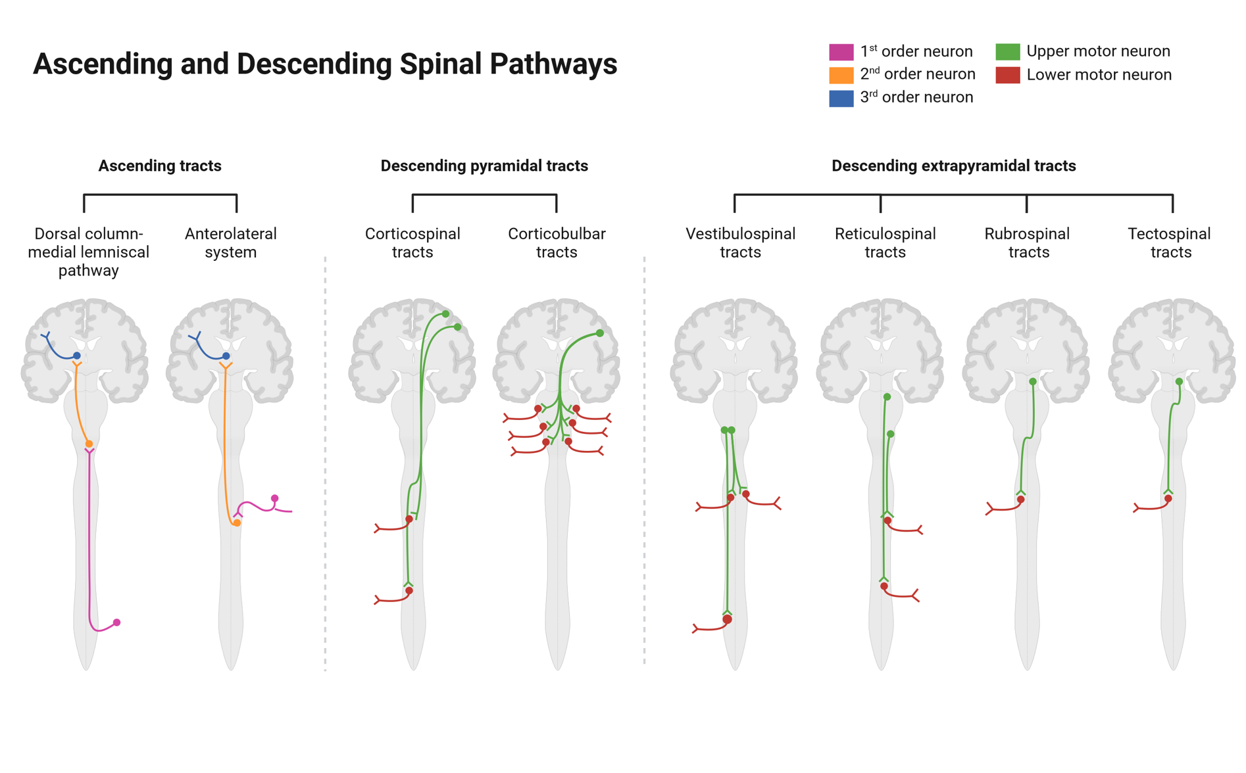

Slide 11
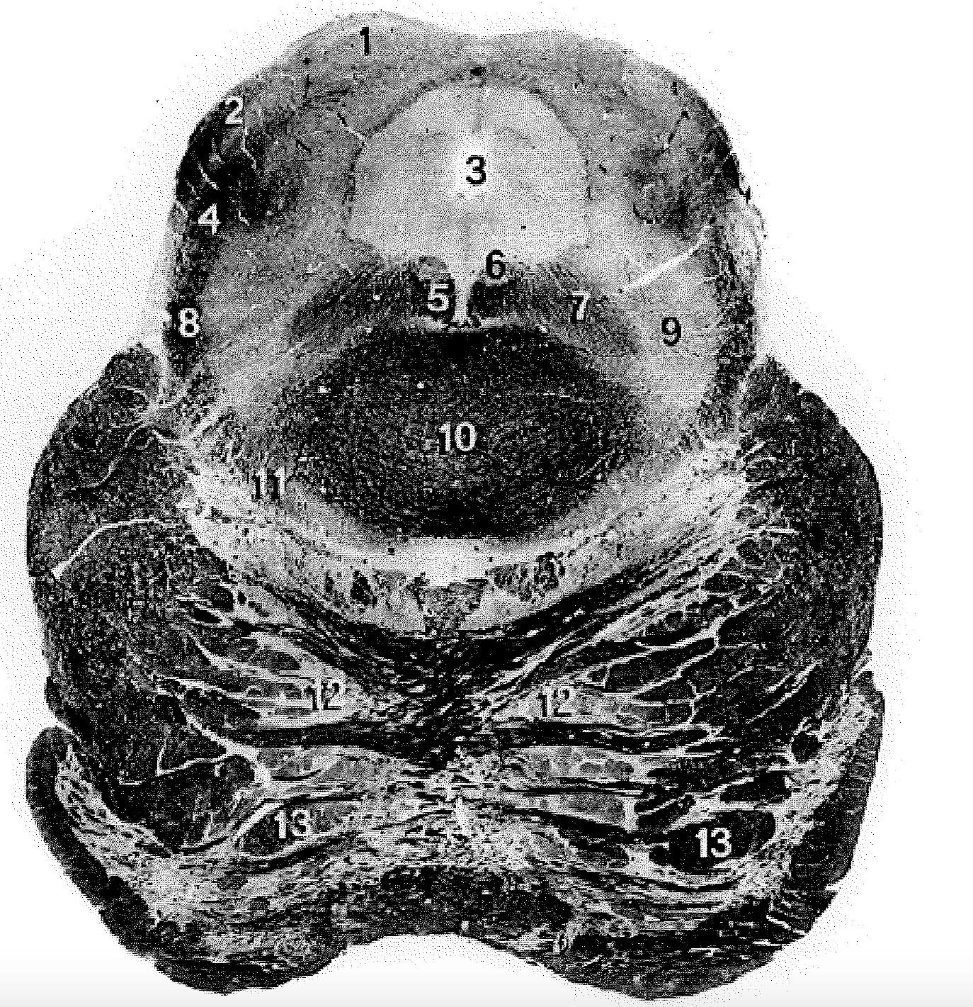
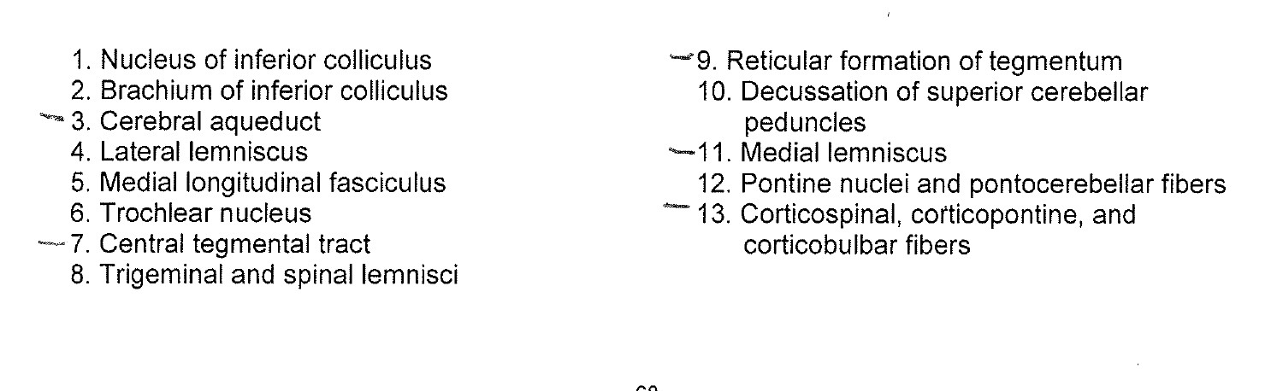
Caudal midbrain

Slide 12
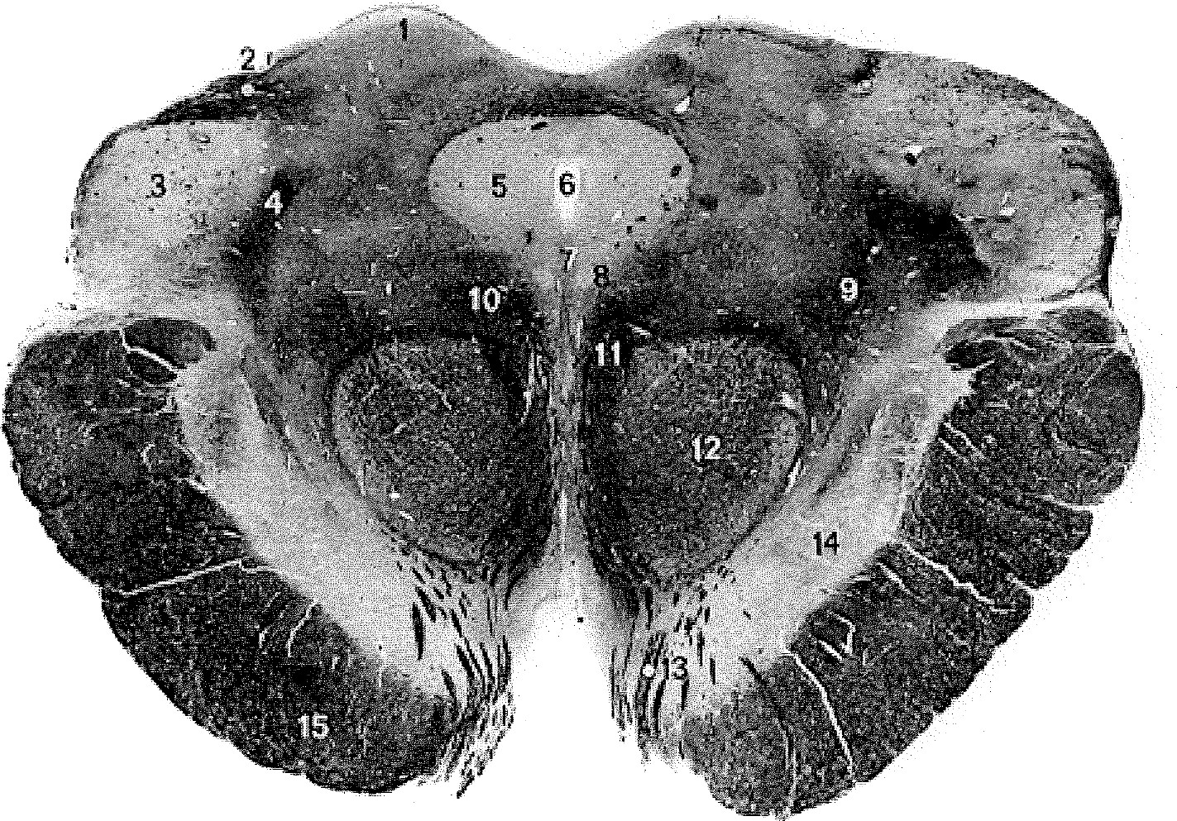
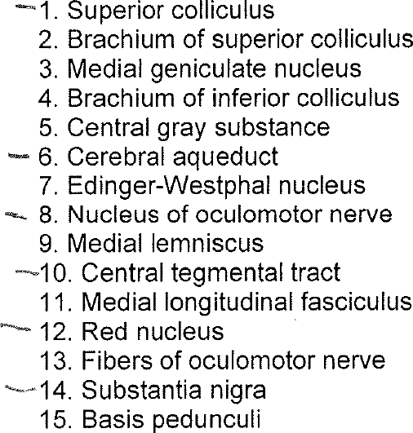
Rostral midbrain

Slide 13
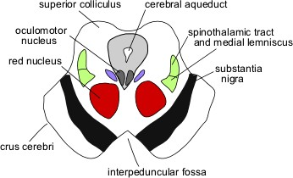

Slide 14
Bonus Points: +5 points on your lowest quiz (out of 100 points)
Make a test with the materials you have learned today (with a test answer key)
Make a study guide
Make a quiz on quizlet
Make note cards with the material
Must include : functions for all midbrain and diencephalon structures that were discussed today.

